Slide 1
The Effect of Collective Attention on Controversial Debates on Social media
Kiran Garimella, Gianmarco De Francisci Morales, Aristides Gionis And Michael Mathioudakis

Slide 2
The Effect of Collective Attention on Controversial Debates on Social media

Slide 3
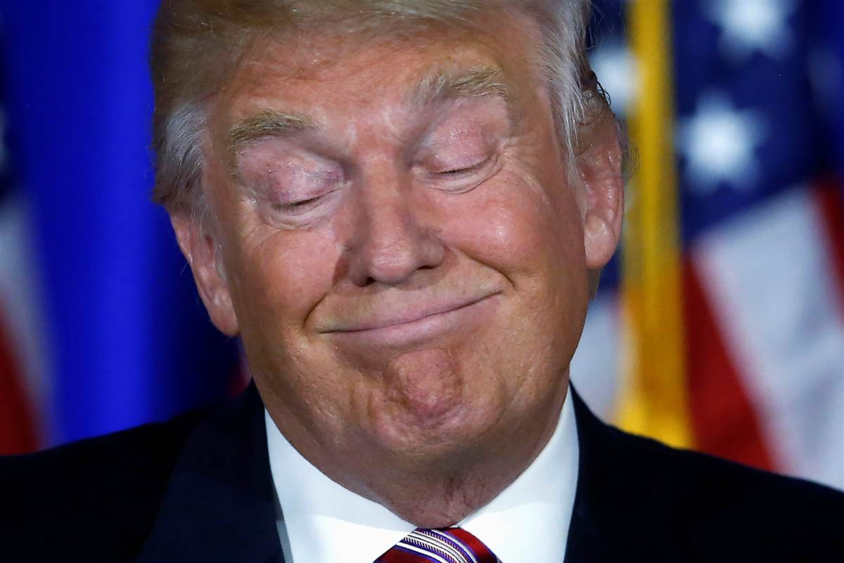
Controversial debates

Slide 4
The Effect of Collective Attention on Controversial Debates on Social media

Slide 5
“Trump taxes”

Slide 6
“Trump taxes”
Rachel maddow show on 2005 tax return

Slide 7
Gun Control on Twitter

Slide 8
Till now...
Controversial debates looked in isolation
As static snapshots

Slide 9
This paper…
Controversial debates are dynamic
They change with collective attention

Slide 10
This paper…
Analyse controversial debates over time
Particularly when there is an increased collective attention
When an external ‘event’ happens

Slide 11
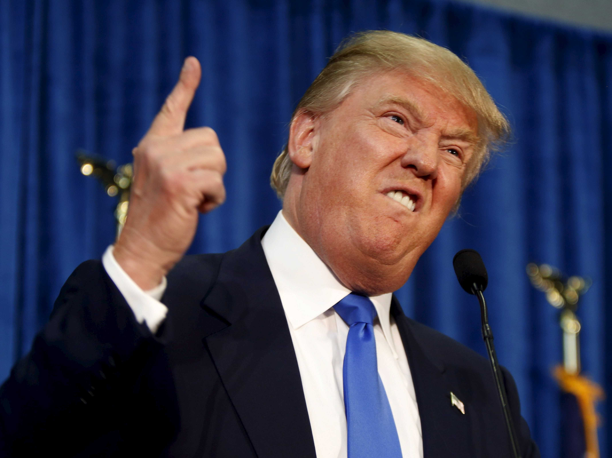
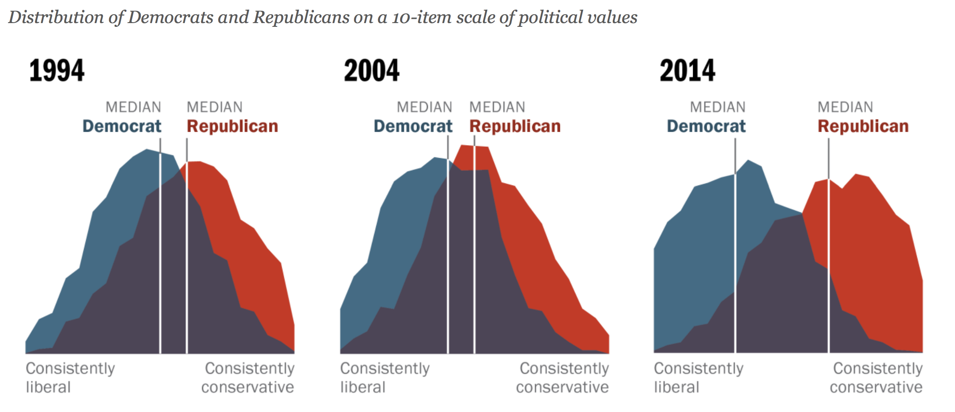
Why do we need this
Polarization everywhere!
Increasing over the years
Controversial debates shape political discourse
Important to understand their properties how they evolve/spread
Notes:
I am not sure if we need this

Slide 12
Data
Twitter
4 longitudinal polarized topics
Obamacare, Abortion, Gun control and Fracking
>5 years (2011 -- 2016)
Hundreds of thousands of users, millions of tweets
Notes:
Mention that we get the topics using keywords and hashtags

Slide 13
Background
Given a controversial topic
Two sides
Retweet network
Measure of polarization
Reply network
Core users

Slide 14
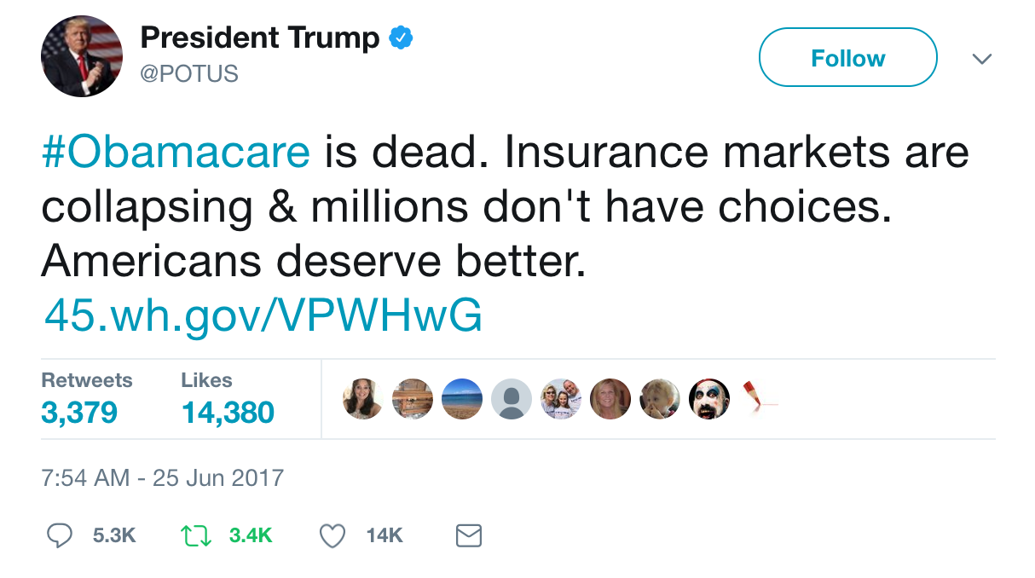
Retweet network
Notes:
One side doesnt retweet the other

Slide 15
Retweet network
2 clear sides – Users don’t retweet the other side

Slide 16
Measure of polarization - RWC
How well does information flow between the sides?
Notes:
Cross edges important

Slide 17
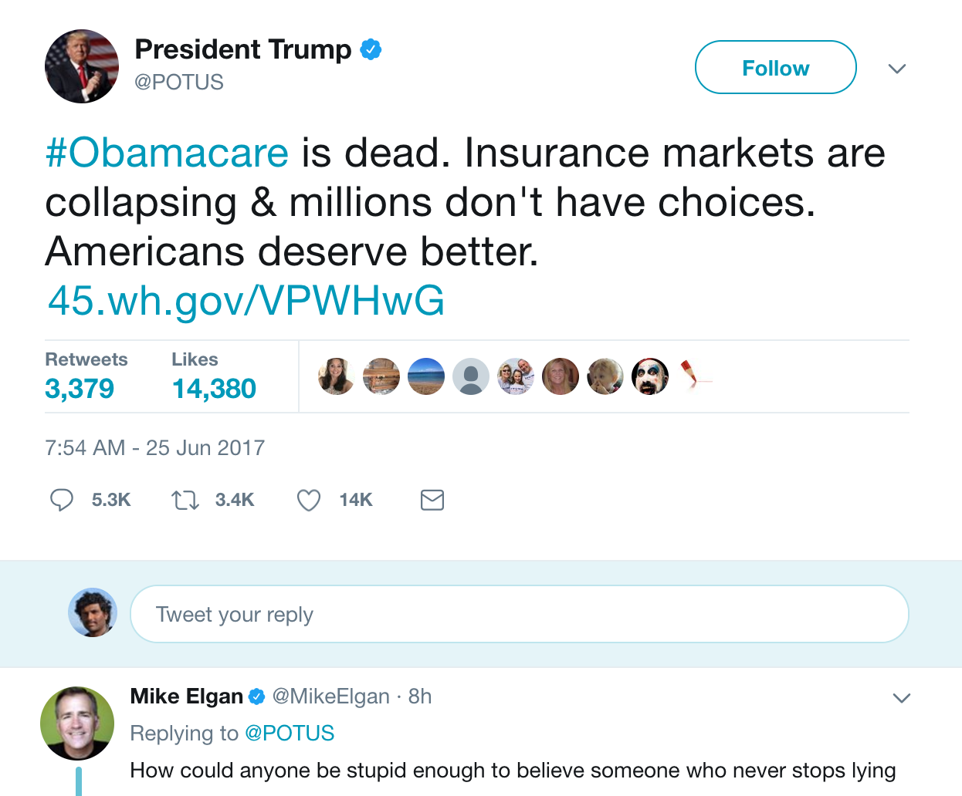
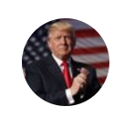
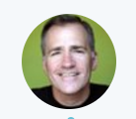
Reply network
Notes:
Discussions are common across sides

Slide 18
Reply network
Users reply to the other side

Slide 19
Core
Core set of users

Slide 20
Experiments
Compare these two points
Network
Content
Unit of measurement

Slide 21
Findings

Slide 22
Retweet network

Slide 23
With increased attention

Slide 24
Increased collective attention
4. Within side retweets increase
3. Across side retweets decrease
1. New users enter the discussion
2. Most retweets to existing core users

Slide 25
New users enter the discussion
New users retweet existing core users
Across side retweets decrease
Within side retweets increase
Polarization increases!

Slide 26
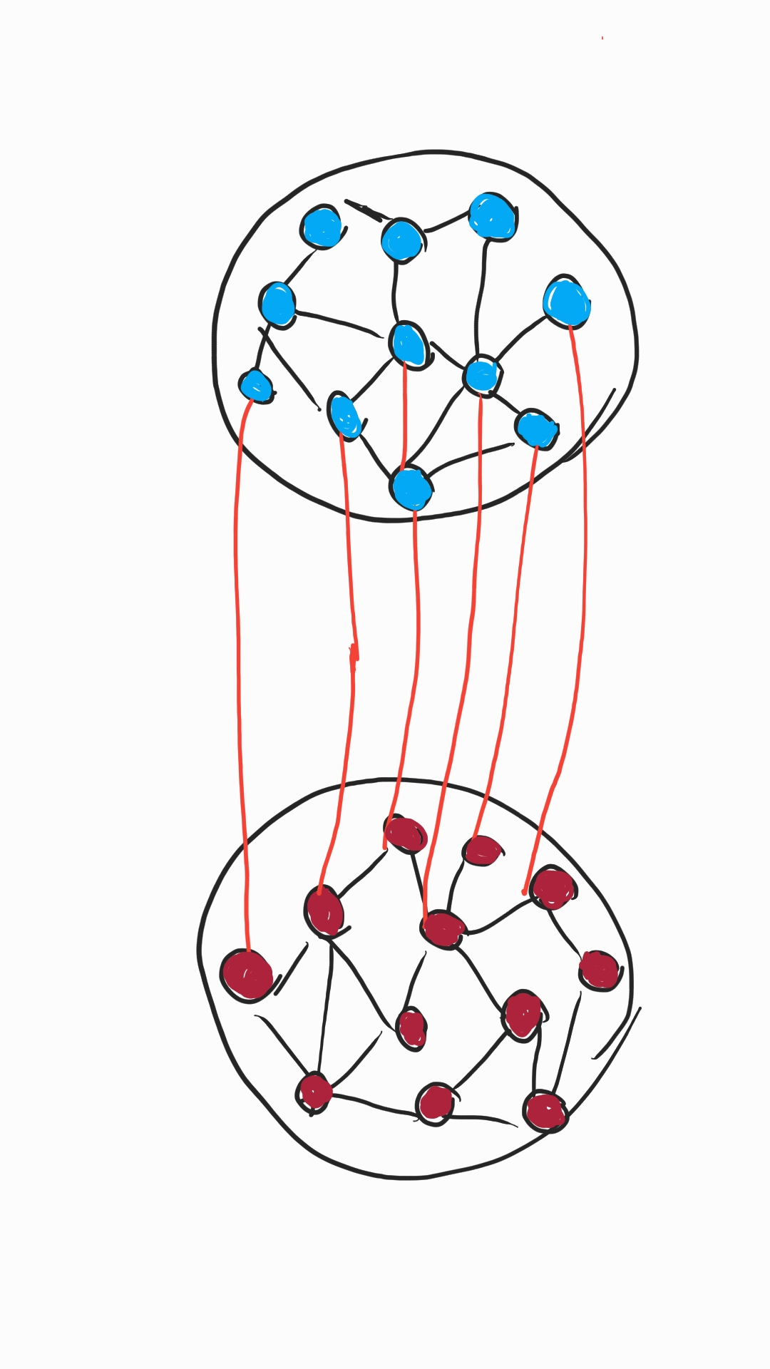
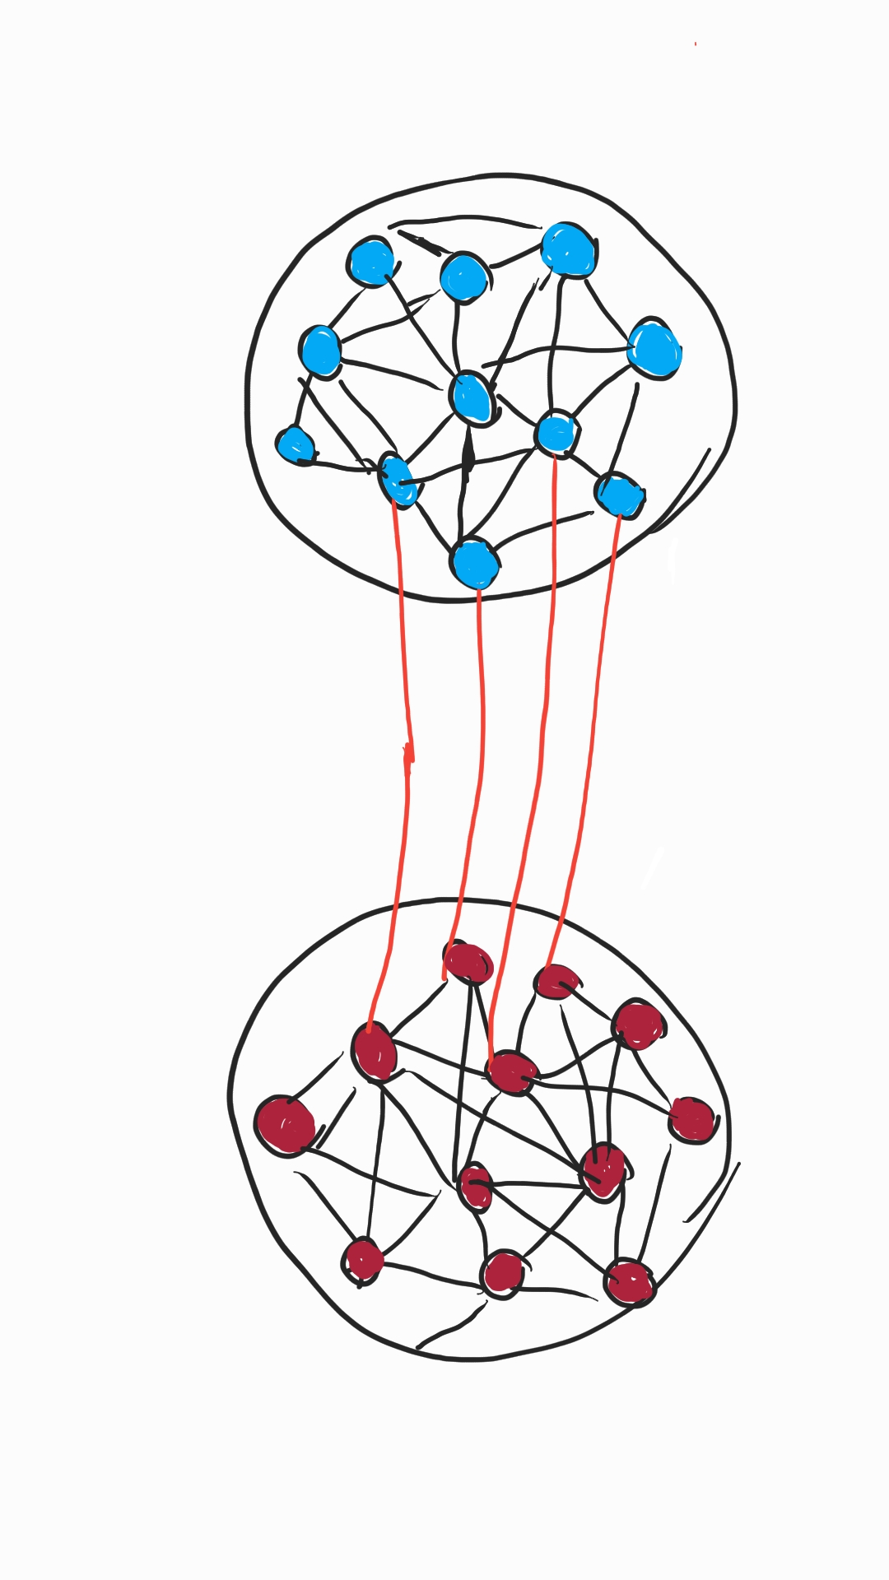
Retweet network
Across side edges decrease
Attention increases
Within side edges increase
Notes:
Rwc increases, clustering coeff increases (network turtles up)
Tie strength increases -> users retweet others from their own side

Slide 27
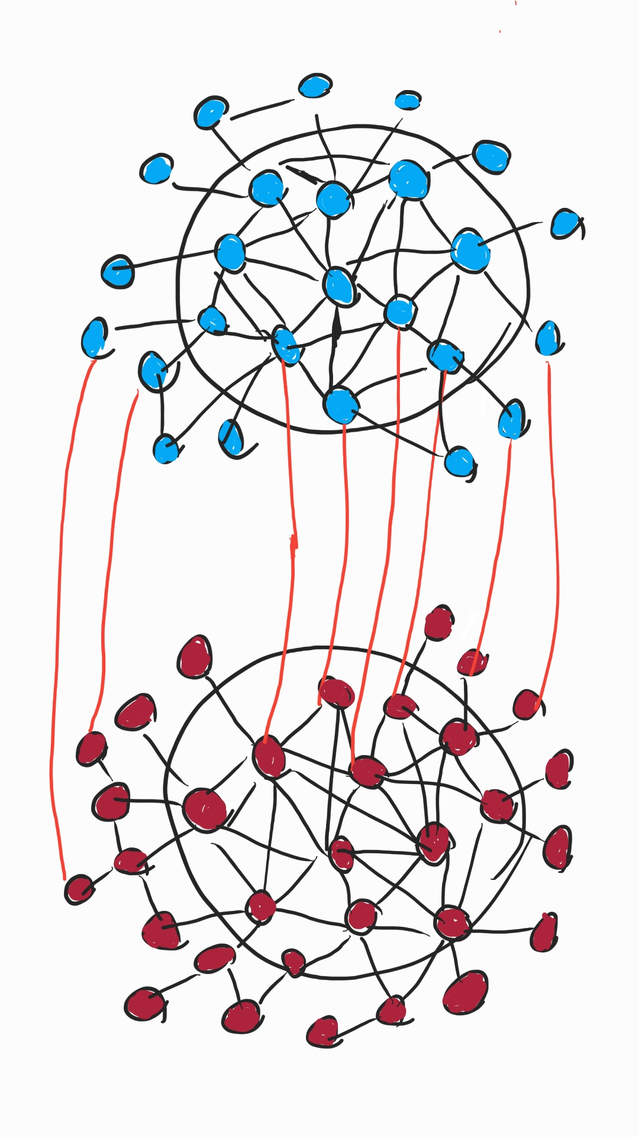
Retweet network - Core
New users entering the discussion
Attention increases
Mostly endorse existing users
Notes:
Rwc increases, clustering coeff increases (network turtles up)
Tie strength increases -> users retweet others from their own side

Slide 28
Reply network
Reply network -- across the side edges increase
More discussion!
Across side edges increase
Attention increases
Notes:
Bimotifs in the reply network increase

Slide 29
Reply network
Reply network -- across the side edges increase
More discussion!
Attention increases

Slide 30
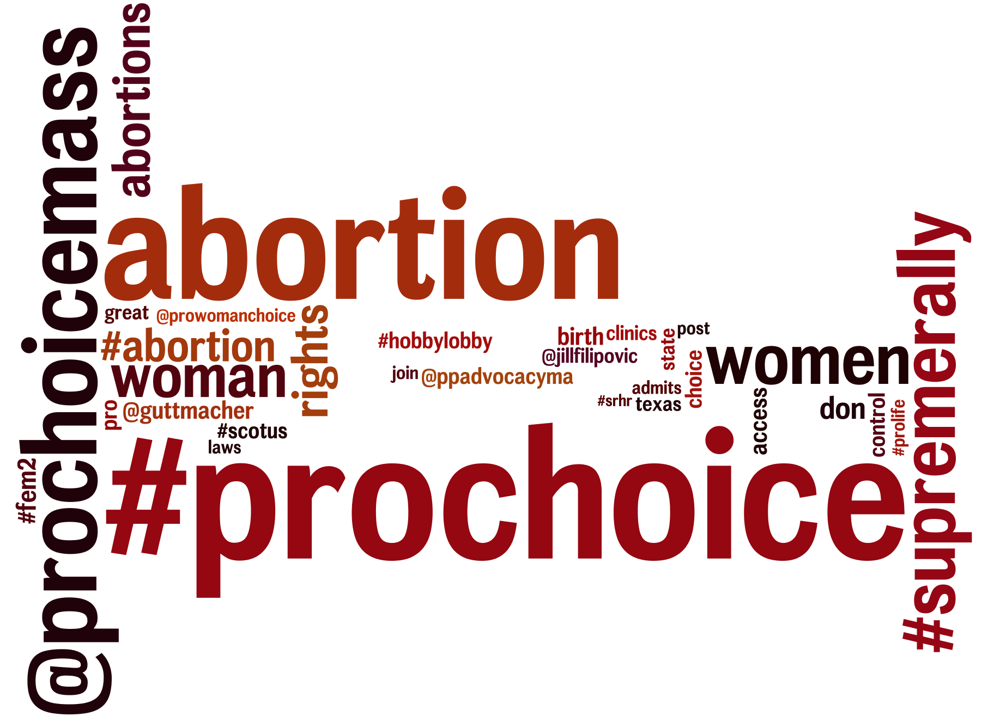
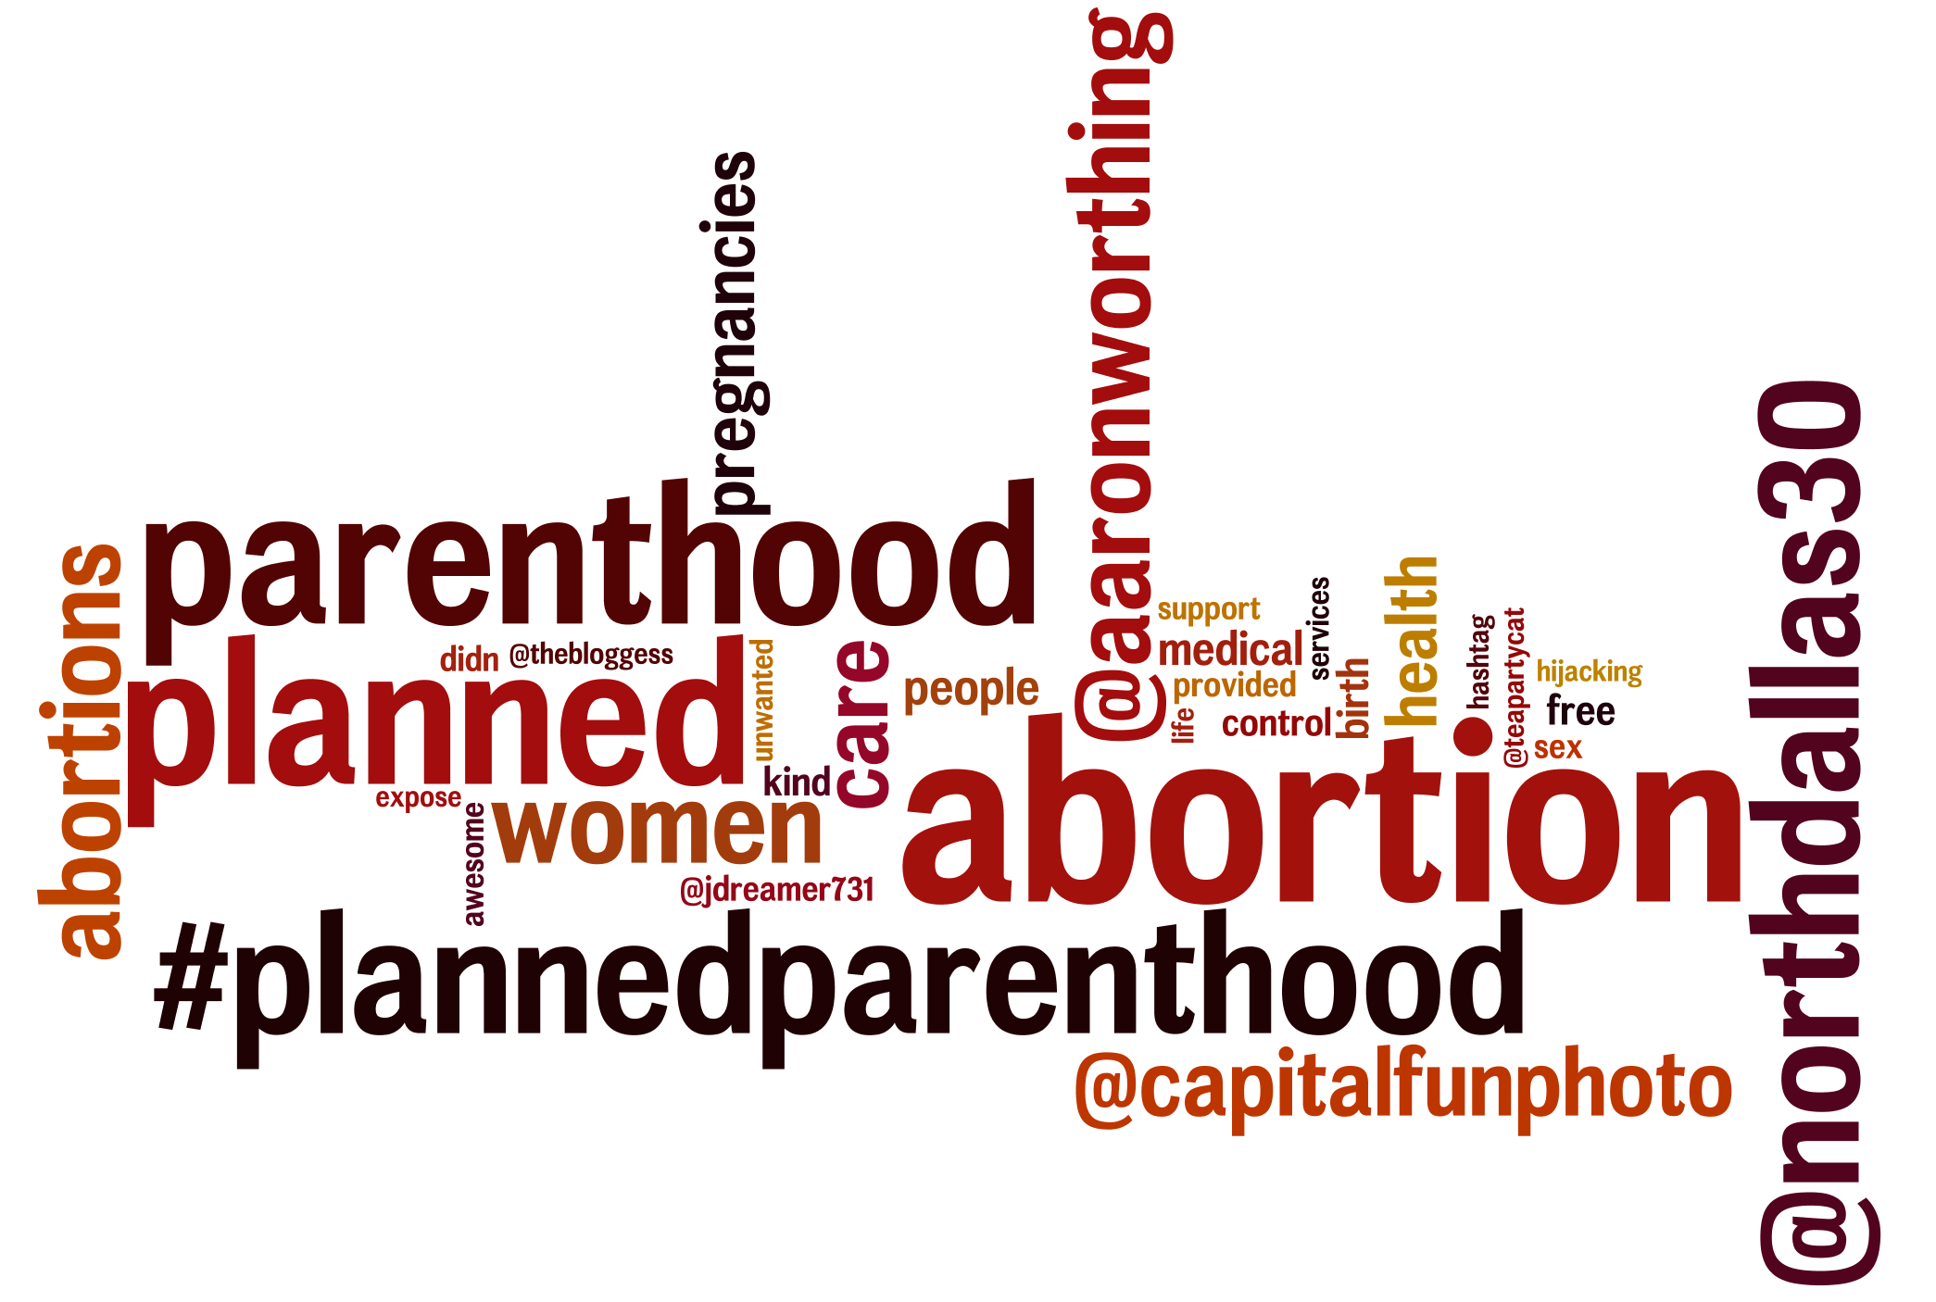
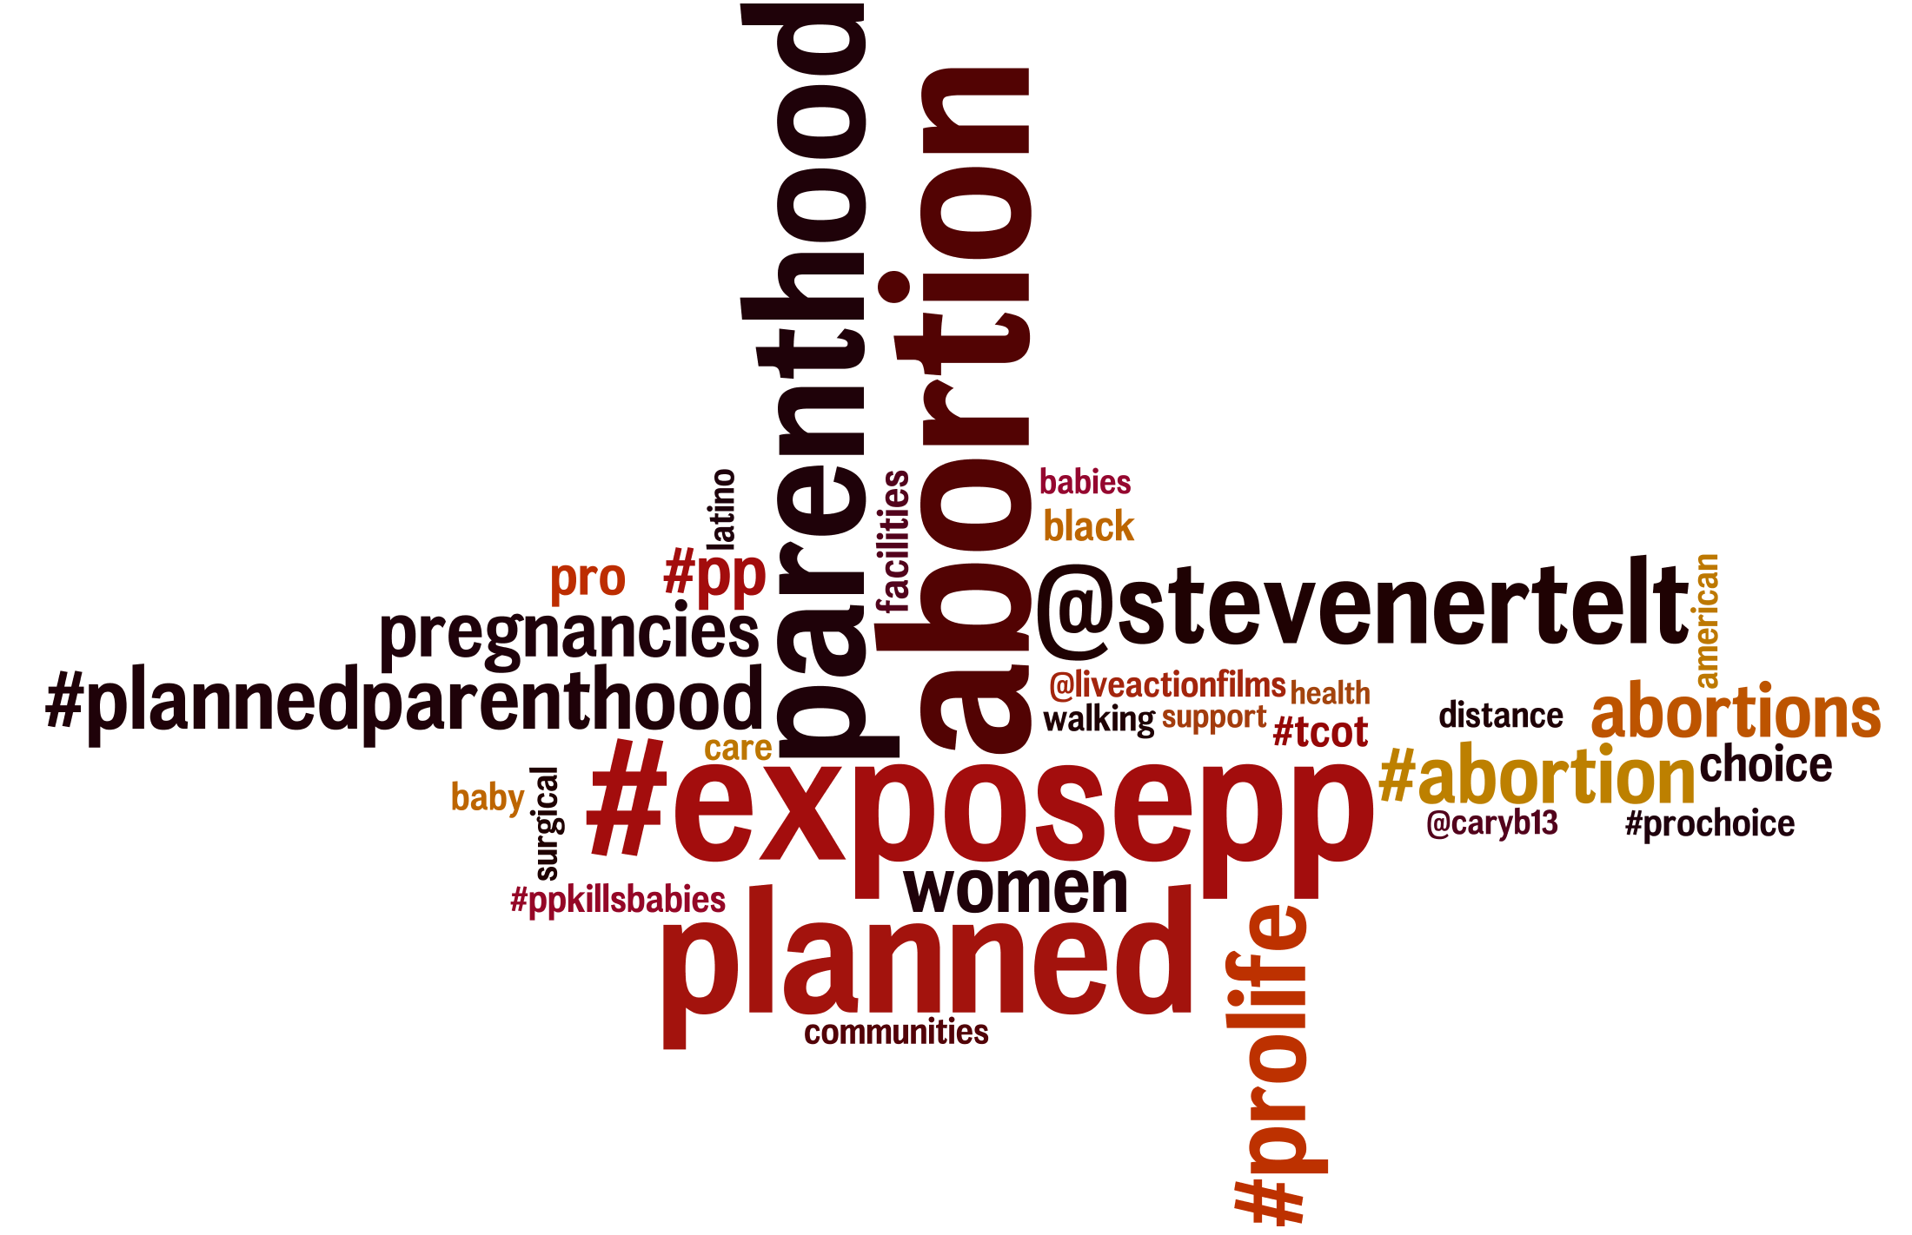
Content
before
Content becomes uniform across the sides
Attention increases

Slide 31
To summarize...
Studied controversial debates
Particularly during external events
Polarization increases
Retweet Network becomes hierarchical
More replies across sides
Content becomes uniform
Many more results in the paper

Slide 32
Thank you!
@gvrkiran, @gdfm7, @gionis, @mmathioudakis
Code and data available: https://mmathioudakis.github.io/polarization
Notes:
Todo: push code

Slide 33
Measures
Measure
Polarization score
Clustering coefficient
Tie strength
Cross-side openness
Sides edge composition
Core-periphery openness
Bi-motif
Core density
Core-periphery edge composition
Cross-side content divergence
Within-side content divergence
Topic variance
Sentiment variance
Psychometric analysis
network based
content based
Notes:
Only focus on a few of those. For the rest, refer to the paper
This will go away

Slide 34
Measure of polarization
How controversial is a topic?
Random walk controversy score (RWC)
Intuitively: How easily does information flow between the two sides
ADD EXAMPLE OF RWC
Notes:
Probably will go

