Slide 1
Factors in Recommending Contrarian Content on Social Media
Kiran Garimella, Gianmarco De Francisci Morales, Aristides Gionis and Michael Mathioudakis

Slide 2
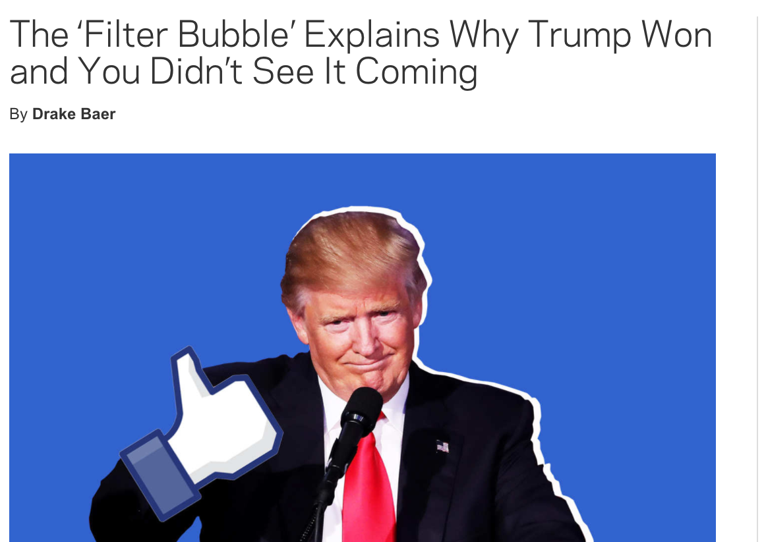
Problem

Slide 3
Problem
Notes:
People on opposing sides don’t talk to each other!
Echo chambers!

Slide 4
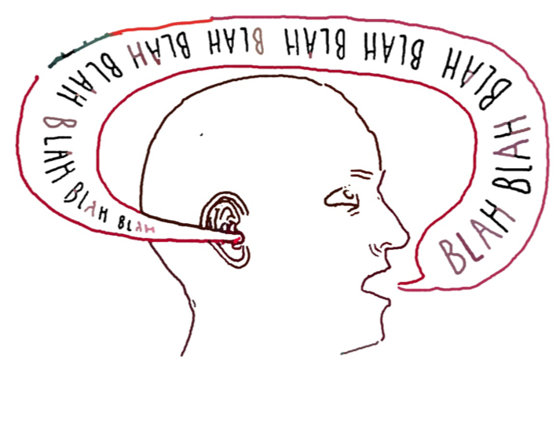
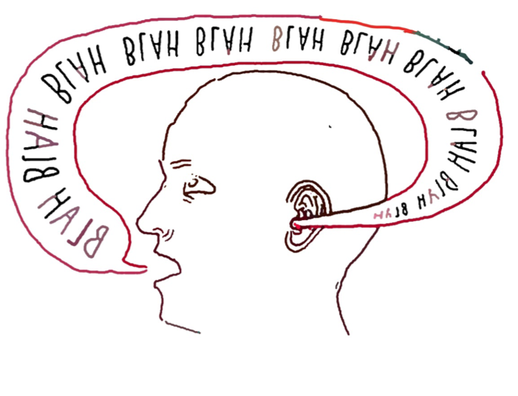
Echo chambers/Filter Bubbles

Slide 5
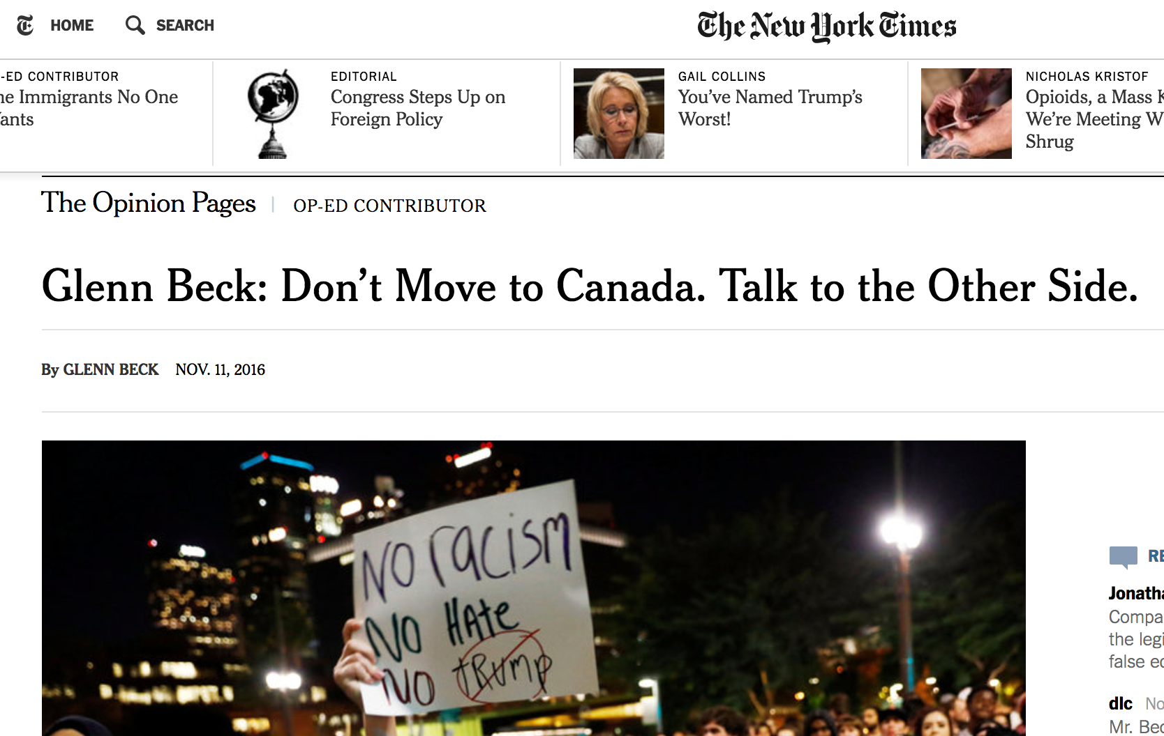
Solution
Talk to the other side!

Slide 6
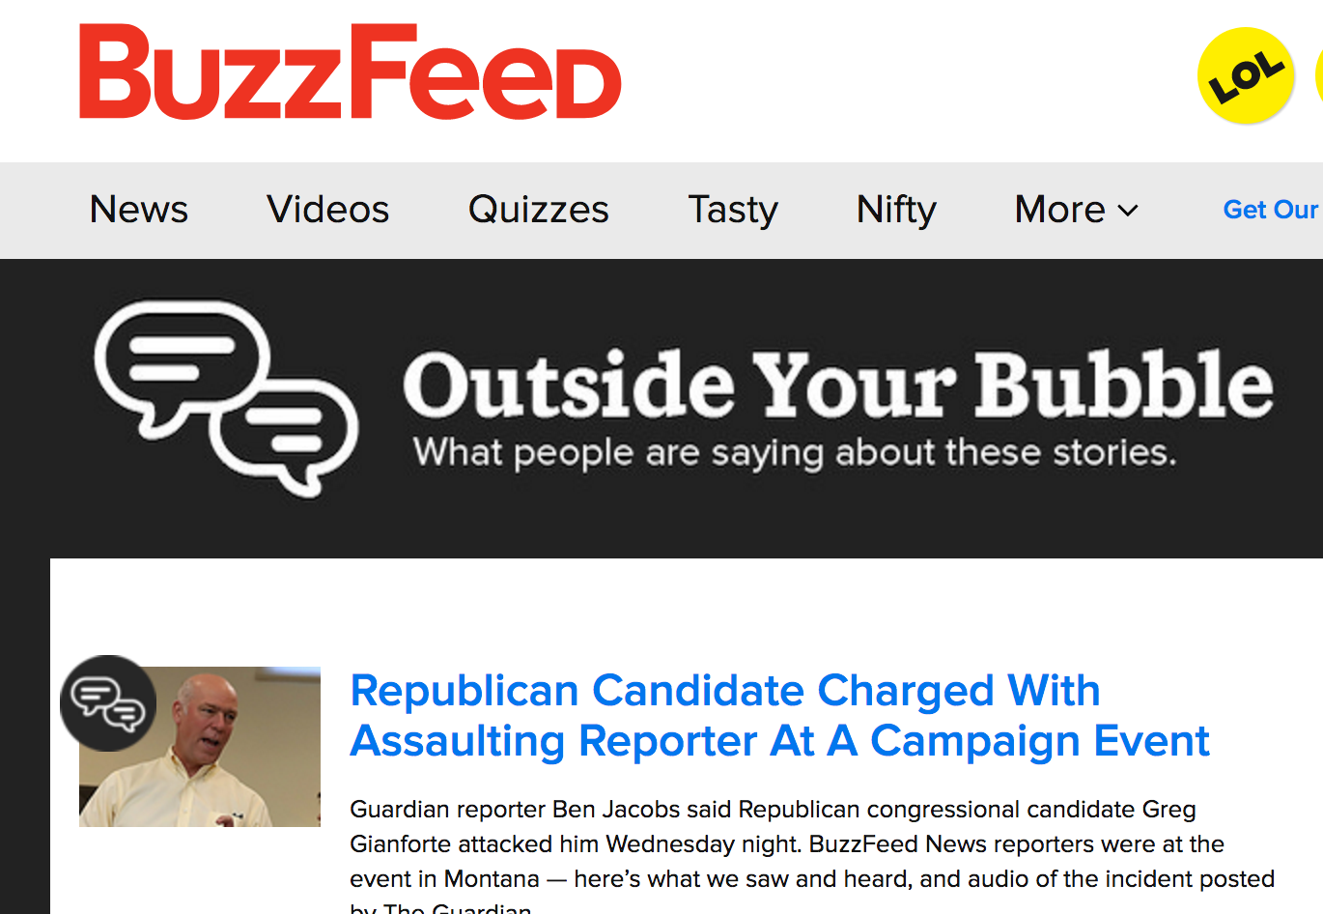
Notes:
Media outlets have tried to do this

Slide 7
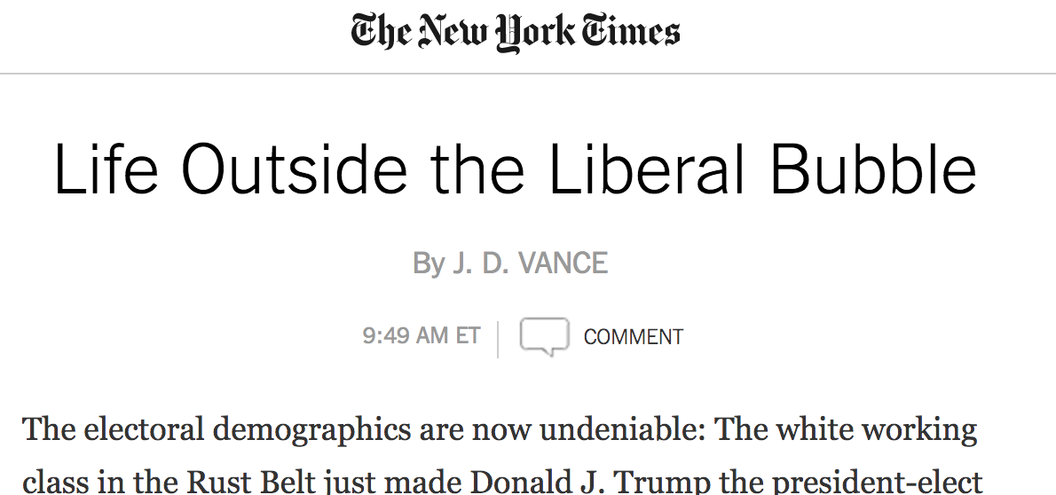

Slide 8
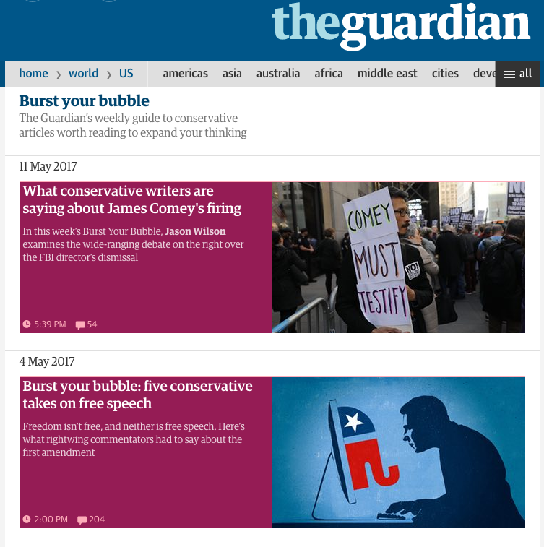
Burst your Bubble

Slide 9
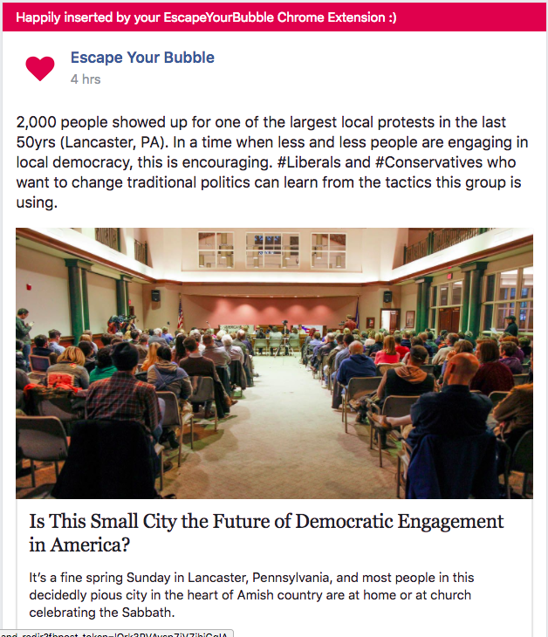
EscapeYourBubble.com
Browser (Chrome) Extension
Injects content into the Facebook feed
Republican / Democrat-leaning articles from the other side

Slide 10
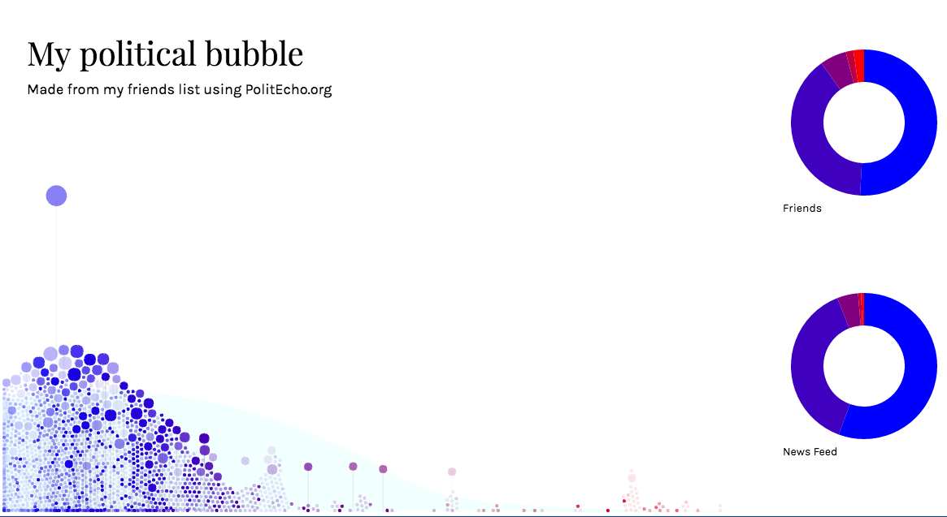
politecho.org
Browser (Chrome) Extension
Shows political distribution of own Facebook feed vs. that of friends

Slide 11
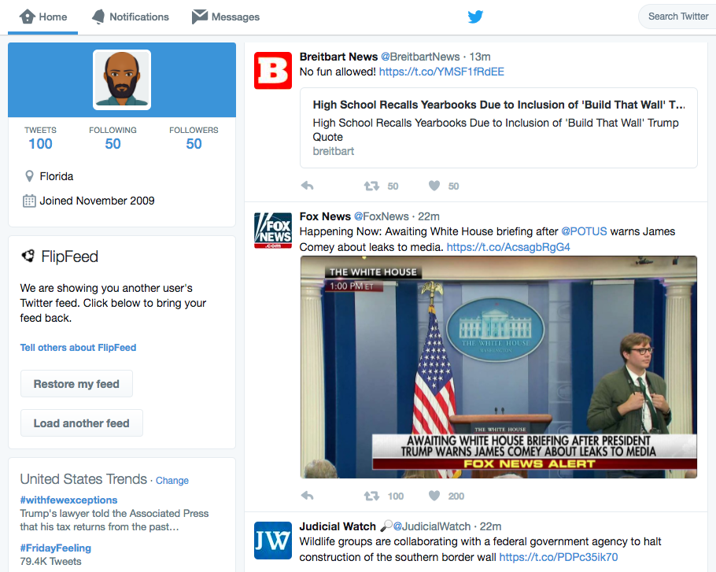
FlipFeed
Browser (Chrome) Extension
Allows Twitter users to see a feed that resembles that of another user

Slide 12
This paper
Algorithmic solution to connect people with opposing views
Specifically, what are some factors we need to consider while doing this?
Completely automated, no human intervention
Twitter

Slide 13
Simple Solution
Identify users from each side of the spectrum (liberals, conservatives)
Show liberal content to a conservative user and vice versa

Slide 14
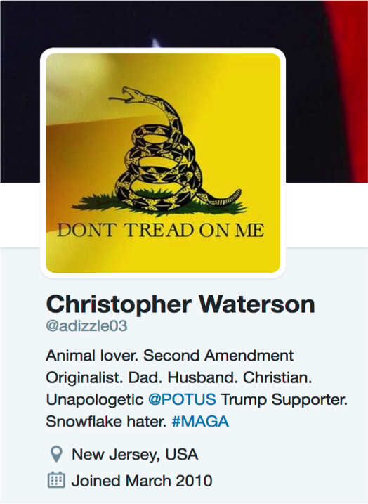
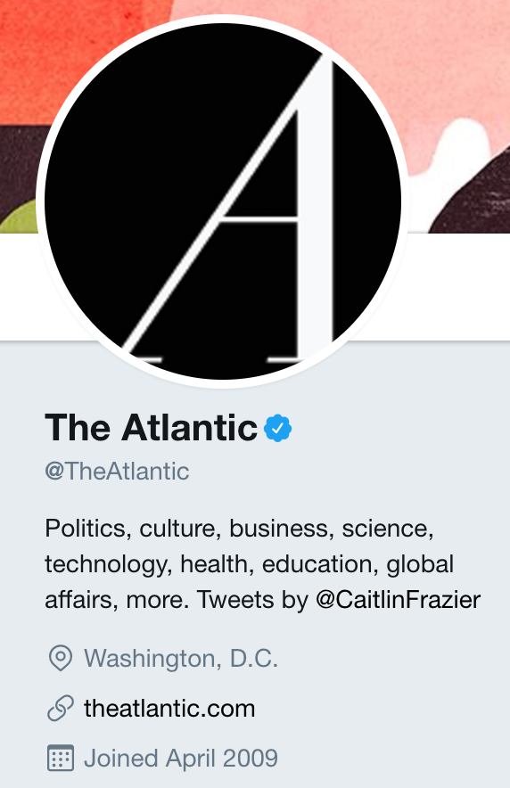
Notes:
Pick a conservative user, show them content from a liberal user

Slide 15
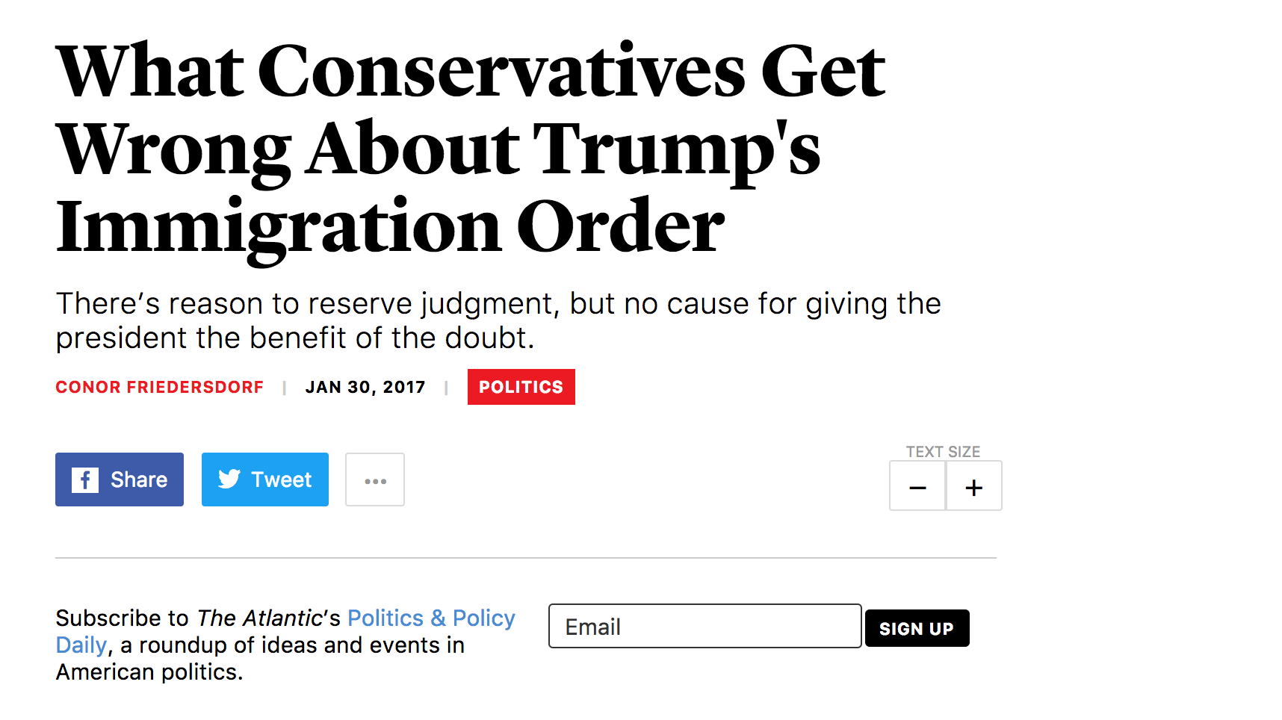
Notes:
Show them content from them

Slide 16
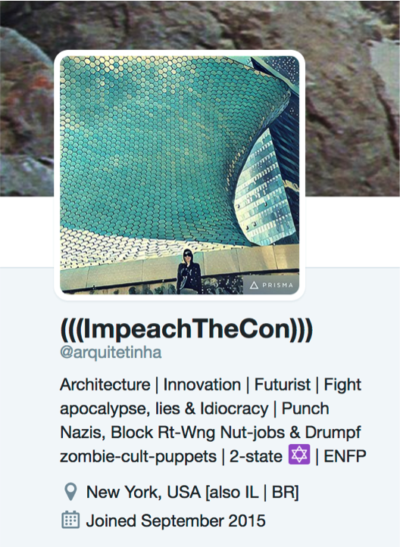
Things can easily go wrong!
Notes:
Could be a disaster!

Slide 17
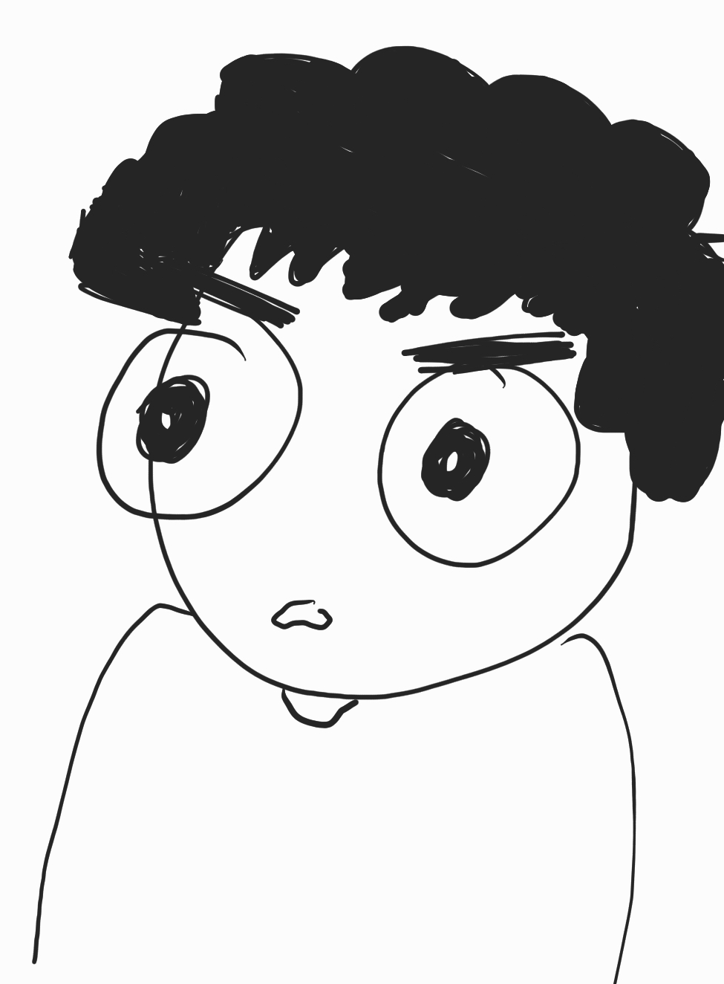
Backfire effect!
If the earth isn’t flat all the ocean water would fall off!!
Are you telling me that the earth is not flat!??
Notes:
Cognitive dissonance
Biased assimilation
Confirmation bias?..

Slide 18
Backfire effect
People don’t like to be challenged.
It might make things worse!
Find a middle ground

Slide 19
Find a middle ground
Don’t connect the extremes.
Find what users find ‘acceptable’
Learn probabilities of users preferences from data

Slide 20
Other factors
Popularity on the other side
How popular is the content
Users might be interested in popular/quality content
Match topical interests of the user
Select recommendations based on user’s topical interest

Slide 21
Final recommendation
Rank aggregation
Combine lists ranked by various approaches
Acceptance probability
Topical interests
Popularity, etc.

Slide 22
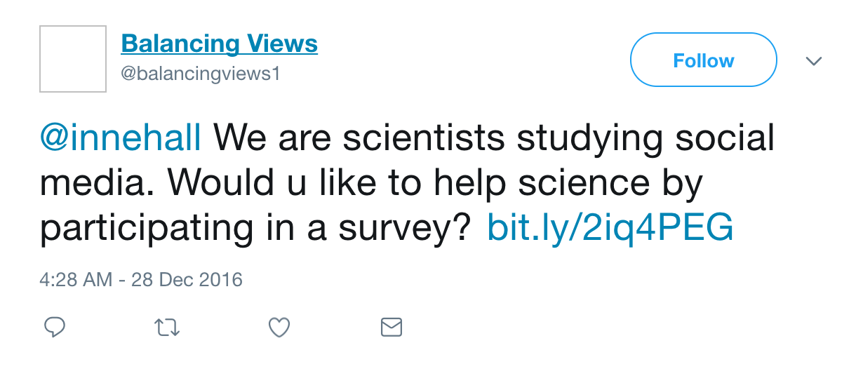
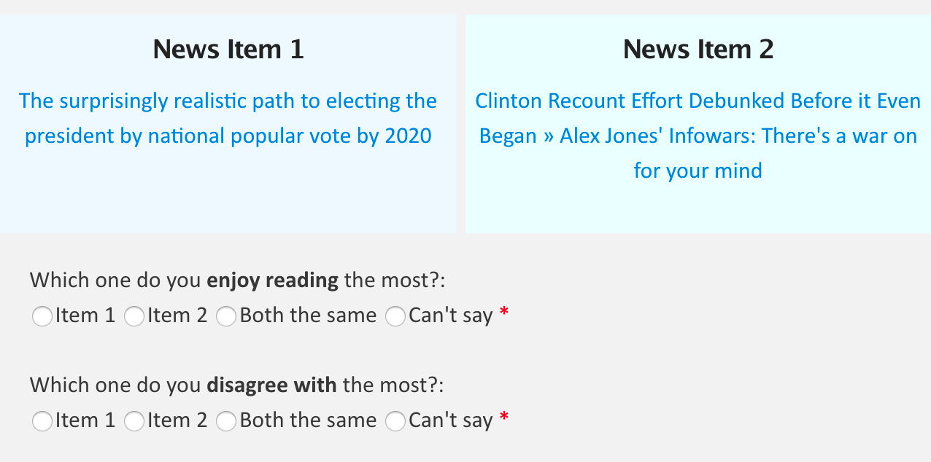
Experiment
Survey
Motive: Do the various factors we hypothesize work?
~7000 twitter users
Mostly positive response

Slide 23
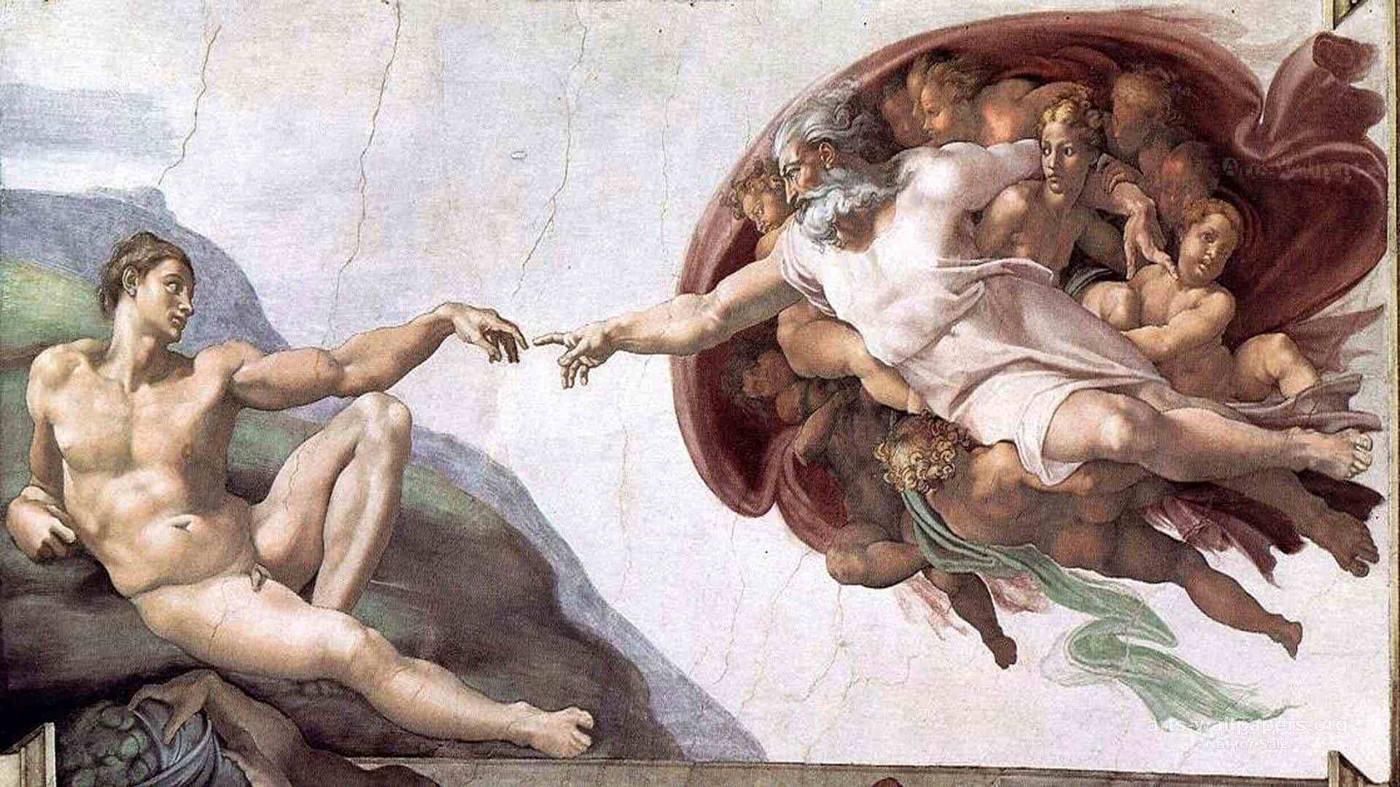
Thank you!
@gvrkiran, @gdfm7, @gionis, @mmathioudakis
Notes:
Illustration connecting opposing sides

Slide 24
Summary
Help people break out of their bubbles
Connecting to opposing viewpoints
Don’t show them a list from the other side
Likely to back fire
Use other factors to smooth out the impact

Slide 25
backup

